Slide 1
Seminar English&culture – methodology for teachers of English
Dublin 25th July – 5th August 2016

Slide 2
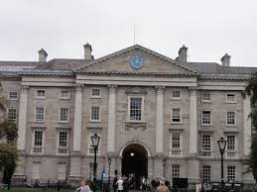
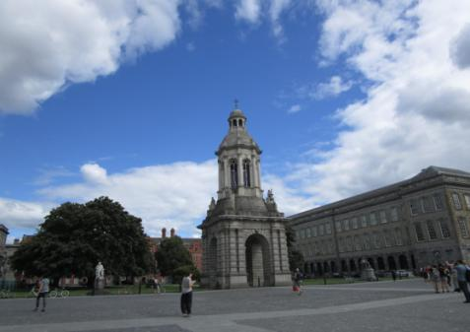
Trinity college
English matters:
Language and culture courses for teachers of English

Slide 3
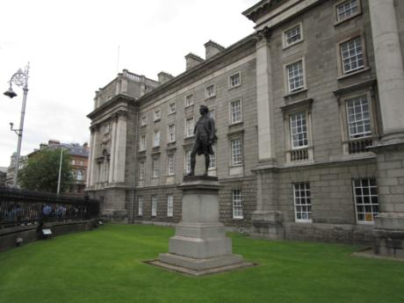
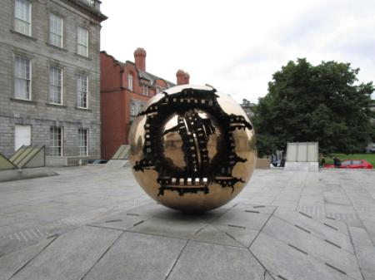
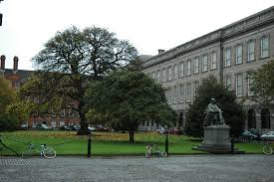
Book of Kells

Slide 4
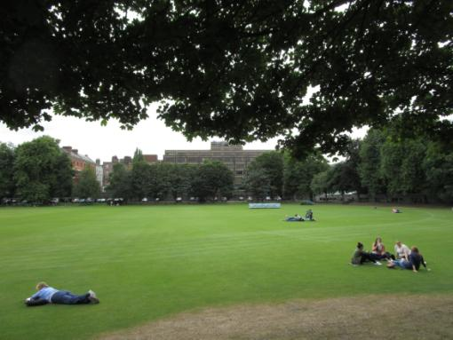
The magnificent
park on the
campus grounds

Slide 5
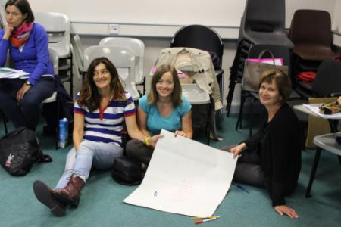
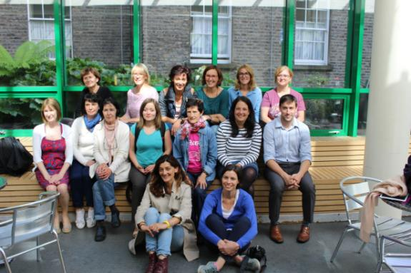
Lectures
and group work,
Intercultural dimension

Slide 6
Inquiry based learning
Topics: language, literature, art, history and heritage
Easter rising 1916
Irish art in context
Irish literature
Modern Irish film
Irish musical tradition
Creative writing, teacher resources
Methodology
Questions - research – discuss – create - present

Slide 7
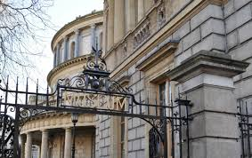
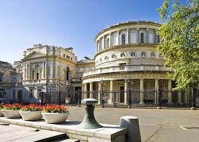
National Library and National Museum

Slide 8
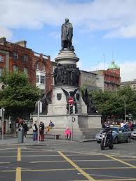
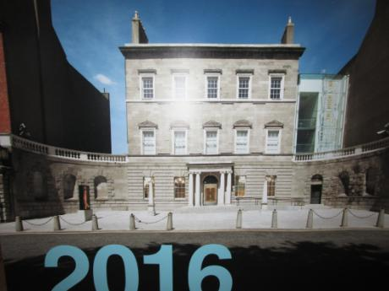
Easter Rising 1916 – 2016
Centenary commemoration

Slide 9
Great Famine Memorial sculptures by the river Liffey

Slide 10
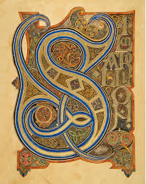
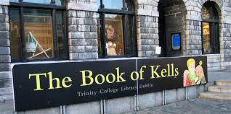
Trinity
The magnificent Trinity College Library with the Book of Kells

Slide 11
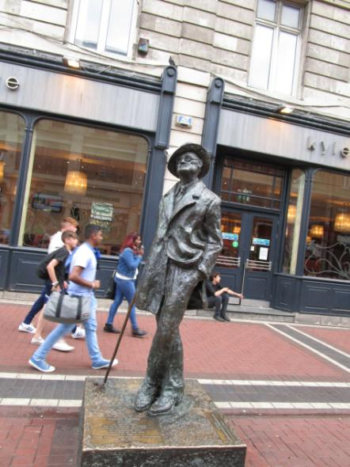
Great Irish poet and writer:
Oscar Wilde and James Joyce

Slide 12
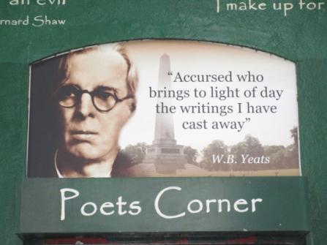
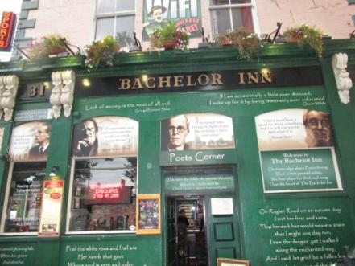
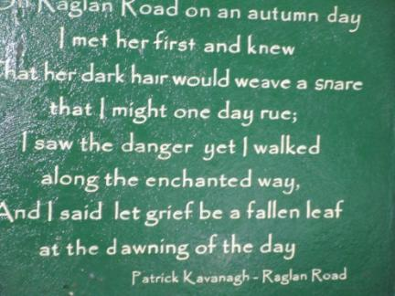

Slide 13
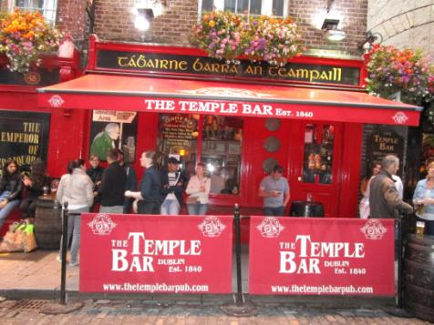
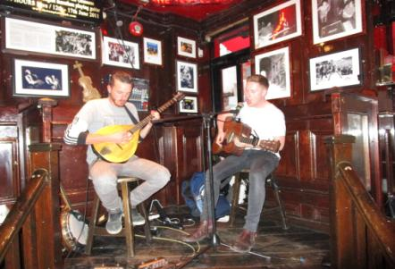
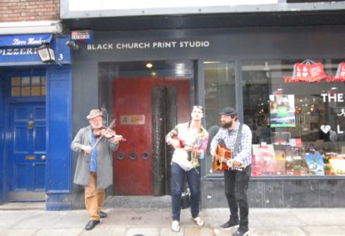
Music – an important part of Irish culture

Slide 14
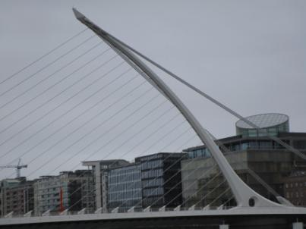
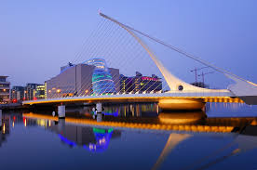
Sillicon docks with Google, Facebook, Twitter , Convention Centre
Sillicon Docks

Slide 15
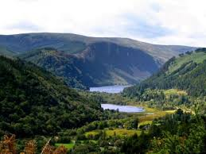
Wicklow mountains, Glendal
Glendalough,
Wicklow mountains,
Kilkenny – Irish cultural
heritage

Slide 16
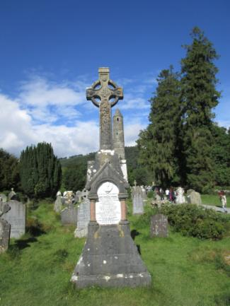
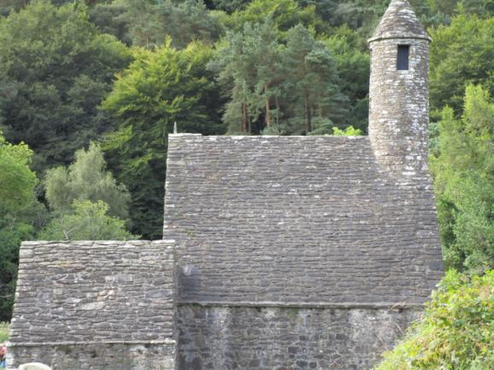
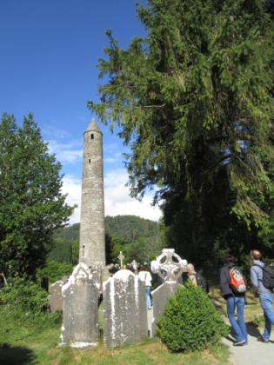
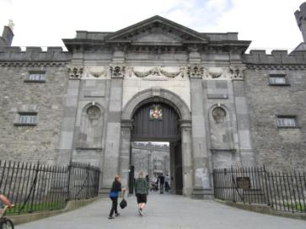
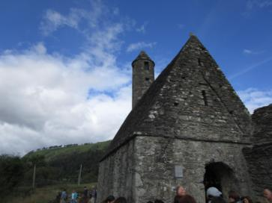
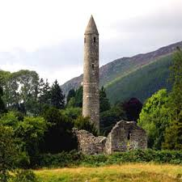
Ekskurzija
Fotke wicklow mountains, kilkenny, glendalough

Slide 17
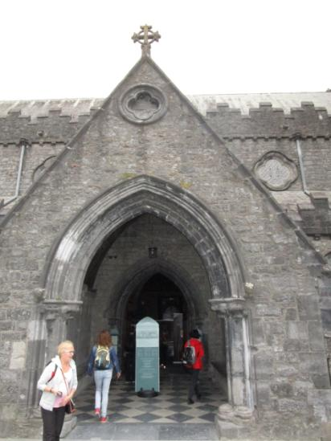
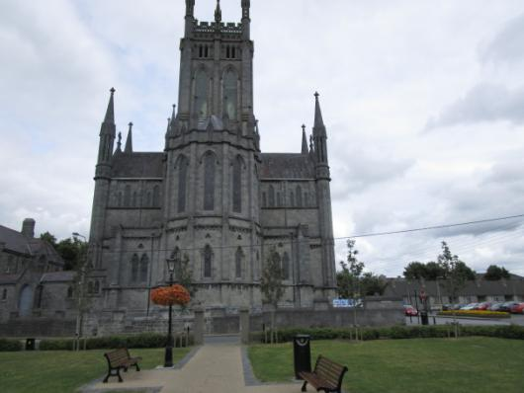
Castle, church and cathedral in Kilkenny

Slide 18
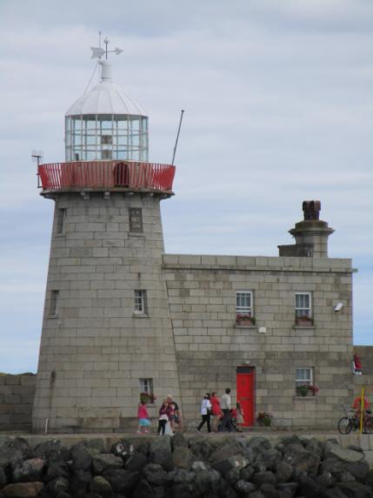
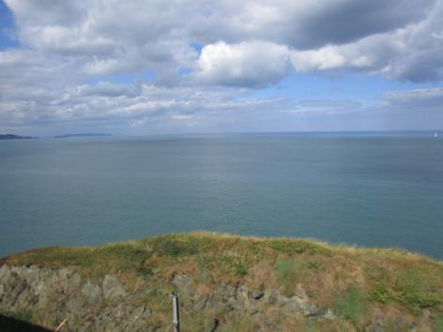
Howth, Bray, Cliffs of Moher

